Slide 1

SRI SIDDHARTHA INSTITUTE OF TECHNOLOGY
Project Phase-2 seminar on
“Gesture Controlled Robot Using Sixth Sense Technology”
PRESENTED BY:
HARSHITHA GL | (15EC022)
HEMAVATHI B | (15EC025)
NITISH KUMAR | (15EC056)
SAQIB MEHMOOD BHAT | (15EC079)
Under the Guidance of
Mrs. Manjula Y
Assistant Professor, Dept. of ECE,
SSIT, TUMKUR

Slide 2
CONTENTS
Introduction
Literature Survey
Hardware Description
System Implementation
System Design Implementation And Algorithm
Applications
Advantages and Disadvantages
Conclusion
References

Slide 3
INTRODUCTION
A gesture is a form of non-verbal communication.
A gesture controlled robot is a kind of robot that can be controlled by using your hand gestures.
Gestures

Slide 4
The objective of this project is to create a sixth sense device which works on the principles of gesture recognition and image processing.
Zooming (in and out), toggling pictures and controlling a robot with ease just by the help of coloured caps worn on the fingertips of the user.
OBJECTIVE
The key motivation of this project is to build a device which bridges the gap between digital world and real world.
And bringing intangible digital information out into the tangible world, and allowing us to interact with this information via natural hand gestures.
MOTIVATION

Slide 5
Our five natural senses are used to analyse and modify the information from our surroundings. But the information which is still in digital form are still untouched.
Still we aren’t have any device which gives the direct link between the digital world and our physical interaction with the real world.
PROBLEM DOMAIN
The sixth sense technology concept is an effort to connect the data in the digital world into the real world.
SOLUTION TO THE PROBLEM

Slide 6
LITERATURE SURVEY
“Drag and Drop: Data Transfer Between Two Digital Devices(ISSN 2348-4470)”
Reviews about Put that there Concept (By Richard Bolt in 1980).
Device used is similar to a pen stylus whose unique Id is stored in a cloud named as Pen Manager.
Two different prototypes are used:
Sparsh.
Slurp.
The two concept overlay the idea that with the help of this interaction ,any file or virtual object can be moved or copied to another location on the same screen.

Slide 7
“A Step Towards Smart city using sixth sense technology(ISSN 2320-7345)”
Tamil Nadu comes second with the allocation of 12 Smart Cities and 33 AMRUT Cities.
The center has partnered with Bloomberg Philanthropies for Smart Cities challenge.
Some Companies like Google are working on technologies to try and integrate parts of sixth sense.
Digital India aims at ensuring that the government services are made available to citizens electronically to reduce paper work.
Traffic management Smart City projects focus on Smart Mobility and Smart Environment.
They are ICT enabled systems, typically based on road sensors or active GPS.

Slide 8
“A Study on Sixth Sense Technology (ISSN 2229-5518)”
This paper focuses on to make us aware with the sixth sense technology which provides an integration of the digital world with the real world.
The methodology used is based on the sixth sense technology where the user will be able to move the cursor by the movement of fingers.
In this paper they have implemented an invisible computer mouse that enables interaction with computer without attaching a hardware mouse.

Slide 9
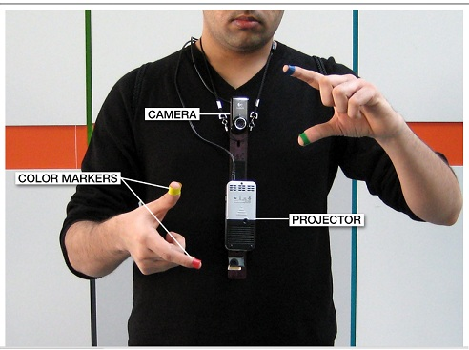
SYSTEM DESIGN
The Devices which are used in Sixth Sense Technology are:
Camera
Coloured Markers
Laptop or Personal Computer
Projector

Slide 10
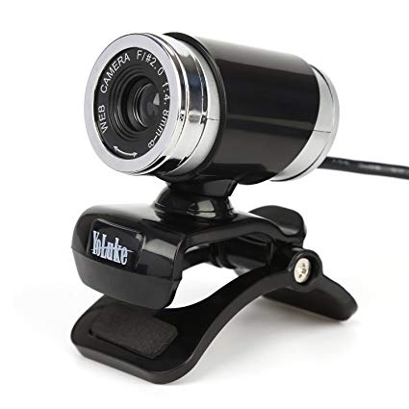
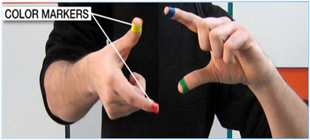
Camera
Captures the objects in view and track the users hand gestures
It sends Data to the Laptop
It acts as a Digital eye connecting us to the world of digital Information
Coloured Markers
It is at the tip of user’s fingers.
Marking the user’s fingers with red, yellow, green or blue tape helps the webcam to recognize the gestures.

Slide 11
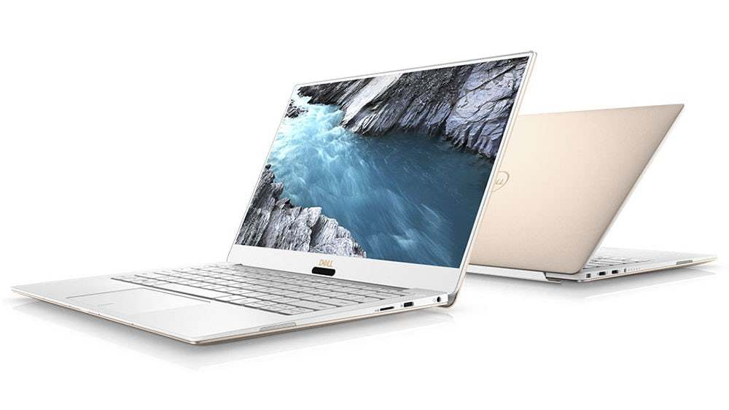
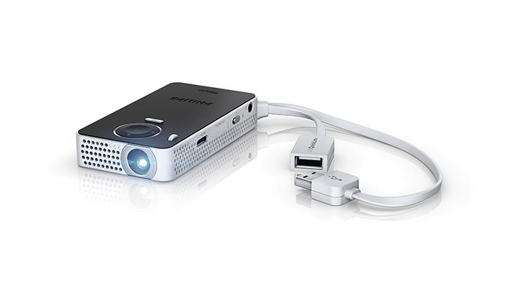
Laptop or Personal Computer
It is used as the processing device that processes the input video data send by the camera.
It is also used for running or implementing the code written on the MATLAB tools for executing the concept of image processing.
Projector
The Projector projects Visual Information enabling surfaces and physical objects to be used as interfaces

Slide 12
Construction And Working
START
Interface the camera with MATLAB and acquire the image/video having gestures.
Detect and recognize the gestures.
Perform the respective real time actions.
STOP

Slide 13

The Process flow can be as follows:
Capture every single frame from the video
Process each frame obtained.
Get the coloured marker channels from the frame by setting threshold.
Subtract the gray scale image from the channel.
Convert the subtracted image into binary image.
Figure: Image after background Subtraction

Slide 14
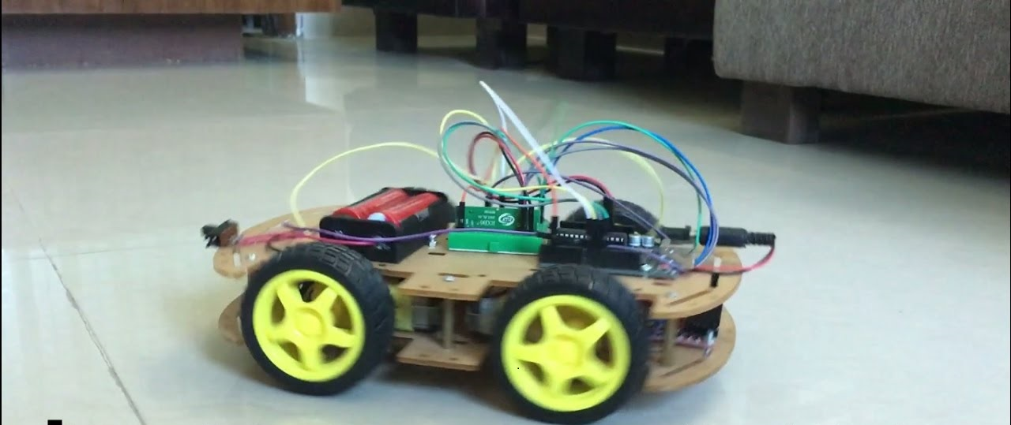
An Example Application: Gesture Controlled Robot
Additional Hardware required
Microcontroller
DC Motor
Motor Driver
Wi-Fi module
RB0 | RB1 | MOTOR STATUS
Low | Low | Stops
Low | High | Anti-Clockwise
High | Low | Clockwise
High | High | Stops
OBJECT USED | MOTOR STATUS
No Object | Stops
One Object | Anti-Clockwise
Two Object | Clockwise

Slide 15
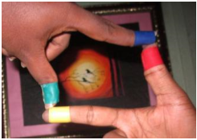
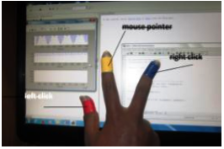
APPLICATIONS
Taking Pictures
Moving mouse pointer using fingers

Slide 16
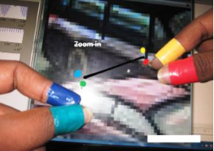
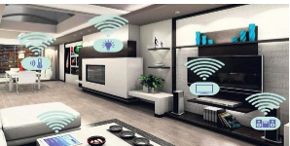
Resizing of Images
Home Automation

Slide 17
ADVANTAGES
One of the main advantages of sixth sense device is its small size and portability. It can be easily carried without any difficulty.
The cost incorporated for the construction of sixth sense prototype is very low. It was made from parts collected together from common devices.
The data access through recognition of hand gestures is much easier and user friendly to the text user interface or graphical user interface which requires keyboard and mouse.
The technology has a user guide that can be used very simply.
It can be a great substitute for a laptop or a computer.

Slide 18
DISADVANTAGES
It will undoubtedly lead to technology addiction as excessive use of technology has already been affecting social lives.
Night vision camera has to be used in darker regions, this might make the technology quite expensive.
Coloured finger caps has to be used for creating an object.

Slide 19
CONCLUSION
The approach has huge potential once it gets further optimized, as its time complexity is higher. It has the potential to completely change man’s perspective about real objects and there will be a thin line and narrow line between our real world and the virtual world.
The information we have extracted from the surveys about the technology is that it can be used as the replacement of the five senses.

Slide 20
REFERENCES
Shailaja Udtewar, Joesh J. Noronha, Yash A. Chheda, “Advanced AR-Augmented Reality using Sixth Sense Technology” International Journal of Engineering Science and Computing, volume: 6 Issue: 5, May 2016.
D.S. Patil, Shahak Patil, “Sixth Sense Technology-A new Innovation” International Journal on Recent and Innovation Trends in Computing and Communication, volume: 2, Issue: 5, May 2014.
Sidharth Rajeev, “Seventh Sense Technology”, 2015 IEEE UP Section conference on Electrical Computer an Electronics (UPCON).
A. Sumithra, K.karthika, J. Jane Ida, “A Step towards Smart city using Sixth Sense Technology”, International Journal of Research in Computer Applications and Robotics, volume: 3, Issue: 9, September 2015.
Akhilesh Waoo, Subhashish Das, “Empowerment of Digital World using Sixth Sense Technology”, American Association for Science and Technology (AASCIT), volume: 4, Issue: 6, August 2.

Slide 21
THANK YOU ANY QUESTIONS

